Slide 1
SHIFT AND ROTATE
Computer Organization and Assembly Language
Computer Science Department
National University of Computer and Emerging Sciences Islamabad

Slide 2
SHIFT AND ROTATE INSTRUCTIONS
Logical vs Arithmetic Shifts
SHL Instruction
SHR Instruction
SAL and SAR Instructions
ROL Instruction
ROR Instruction
RCL and RCR Instructions

Slide 3


LOGICAL VS ARITHMETIC SHIFTS
A logical shift fills the newly created bit position with zero:
An arithmetic shift fills the newly created bit position with a copy of the number’s sign bit:

Slide 4

SHL INSTRUCTION
The SHL (shift left) instruction performs a logical left shift on the destination operand, filling the lowest bit with 0.
Operand types for SHL: SHL destination,count
SHL reg,imm8
SHL mem,imm8
SHL reg,CL
SHL mem,CL
(Same for all shift and rotate instructions)
Notes:
CL- low part of CX register

Slide 5

FAST MULTIPLICATION
Shifting left 1 bit multiplies a number by 2
mov dl,5
shl dl,1
Shifting left n bits multiplies the operand by 2^{n}
For example, 5 * 2² = 20
mov dl,5
shl dl,2 ; DL = 20

Slide 6
SHR INSTRUCTION
The SHR (shift right) instruction performs a logical right shift on the destination operand. The highest bit position is filled with a zero.
Shifting right n bits divides the operand by 2^{n}
mov dl,80
shr dl,1 ; DL = 40
shr dl,2 ; DL = 10

Slide 7
SAL AND SAR INSTRUCTIONS
SAL (shift arithmetic left) is identical to SHL.
SAR (shift arithmetic right) performs a right arithmetic shift on the destination operand.
An arithmetic shift preserves the number's sign.
mov dl,-80
sar dl,1 ; DL = -40
sar dl,2 ; DL = -10

Slide 8
YOUR TURN . . .
Indicate the hexadecimal value of AL after each shift:
mov al,6Bh ; 01101011
shr al,1 a.
shl al,3 b.
mov al,8Ch ; 10001100
sar al,1 c.
sar al,3 d.
35h
A8h
C6h
F8h

Slide 9

ROL INSTRUCTION
ROL (rotate) shifts each bit to the left
The highest bit is copied into both the Carry flag and into the lowest bit
No bits are lost
mov al,11110000b
rol al,1 ; AL = 11100001b
mov dl,3Fh
rol dl,4 ; DL = F3h

Slide 10

ROR INSTRUCTION
ROR (rotate right) shifts each bit to the right
The lowest bit is copied into both the Carry flag and into the highest bit
No bits are lost
mov al,11110000b
ror al,1 ; AL = 01111000b
mov dl,3Fh
ror dl,4 ; DL = F3h

Slide 11
YOUR TURN . . .
Indicate the hexadecimal value of AL after each rotation:
mov al,6Bh ; 01101011
ror al,1 a.
rol al,3 b.
B5h
ADh

Slide 12
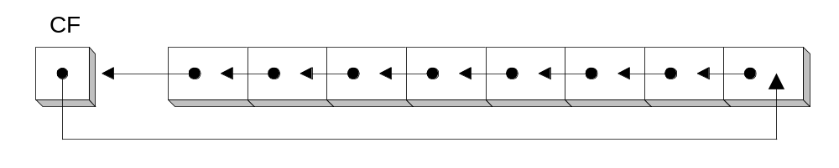
RCL INSTRUCTION
RCL (rotate carry left) shifts each bit to the left
Copies the Carry flag to the least significant bit
Copies the most significant bit to the Carry flag
clc ; CF = 0
mov bl,88h ; CF,BL = 0 10001000b
rcl bl,1 ; CF,BL = 1 00010000b
rcl bl,1 ; CF,BL = 0 00100001b

Slide 13
RCR INSTRUCTION
RCR (rotate carry right) shifts each bit to the right
Copies the Carry flag to the most significant bit
Copies the least significant bit to the Carry flag
stc ; CF = 1
mov ah,10h ; CF,AH = 1 00010000b
rcr ah,1 ; CF,AH = 0 10001000b

Slide 14
YOUR TURN . . .
Indicate the hexadecimal value of AL after each rotation:
stc
mov al,6Bh
rcr al,1 a.
rcl al,3 b.
B5h
AEh

Slide 15
SHIFT AND ROTATE APPLICATIONS
Binary Multiplication
Displaying Binary Bits
Isolating a Bit String
Shifting Multiple Doublewords

Slide 16
BINARY MULTIPLICATION
We already know that SHL performs unsigned multiplication efficiently when the multiplier is a power of 2.
You can factor any binary number into powers of 2.
  For example, to multiply EAX * 36, factor 36 into 32 + 4 and use the distributive property of multiplication to carry out the operation:
EAX * 36
= EAX * (32 + 4)
= (EAX * 32)+(EAX * 4)
mov eax,123
mov ebx,eax
shl eax,5 ; mult by 2⁵
shl ebx,2 ; mult by 2²
add eax,ebx

Slide 17
YOUR TURN . . .
Multiply AX by 26, using shifting and addition instructions. Hint: 26 = 16 + 8 + 2.
mov ax,2 ; test value
mov dx,ax
shl dx,4 ;2 ; AX * 16
push dx ; save for later
mov dx,ax
shl dx,3 ; AX * 8
shl ax,1 ; AX * 2
add ax,dx ; AX * 10
pop dx ; recall AX * 16
add ax,dx ; AX * 26

Slide 18
DISPLAYING BINARY BITS
Algorithm: Shift MSB into the Carry flag; If CF = 1, append a "1" character to a string; otherwise, append a "0" character. Repeat in a loop, 32 times.
.data
binVal DWORD 1234ABCDh
buffer BYTE 32 DUP(0),0
.code
mov eax, binVal
mov cx,32 ;counter
mov esi,OFFSET buffer
L1: shl eax,1 ;shift high bit into CF
mov BYTE PTR [esi],'0‘ ;choose 0 as default digit
jnc L2 ;if no carry jump to L2
mov BYTE PTR [esi],'1‘ ;else move 1 to buffer
L2: inc esi ;next buffer position
loop L1 ;shift another bit to the
;left

Slide 19
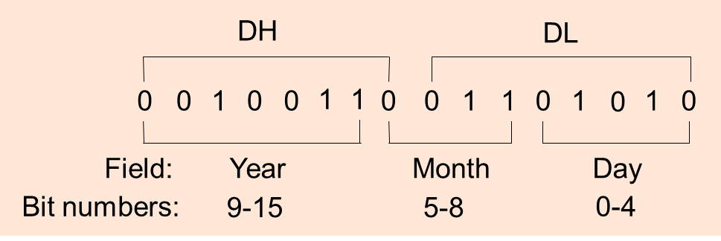
ISOLATING A BIT STRING
The MS-DOS file date field packs the year, month, and day into 16 bits:
To extract a single field, we can shift its bits into the lower part of a register and clear the irrelevant bit positions.

Slide 20
ISOLATING A BIT STRING (CONT.)
mov al,dl ; make a copy of DL
and al,00011111b ; clear bits 5-7
mov day,al ; save in day variable
mov ax,dx ; make a copy of DX
shr ax,5 ; shift right 5 bits
and al,00001111b ; clear bits 4-7
mov month,al ; save in month variable
mov al,dh ; make a copy of DX
shr al,1 ; shift right 1 bit
mov ah,0 ; clear AH to 0
add ax,1980 ; year is relative to 1980
mov year,ax ; save in year

Slide 21
SHIFTING MULTIPLE DOUBLEWORDS
Programs sometimes need to shift all bits within an array, as one might when moving a bitmapped graphic image from one screen location to another.
The following shifts an array of 3 doublewords 1 bit to the right
.data
ArraySize = 3
array DWORD ArraySize DUP(99999999h) ; 1001 1001...
.code
mov esi,0
shr array[esi + 8],1 ; high dword
rcr array[esi + 4],1 ; middle dword, include Carry
rcr array[esi],1 ; low dword, include Carry
[esi+8]
[esi+4]
[esi]

Slide 22
REFERENCE
Assembly Language for x86 Processors
    Sec 7.1,7.2
    Chapter#7
      Kip R. Irvine
      7th edition

